Slide 1
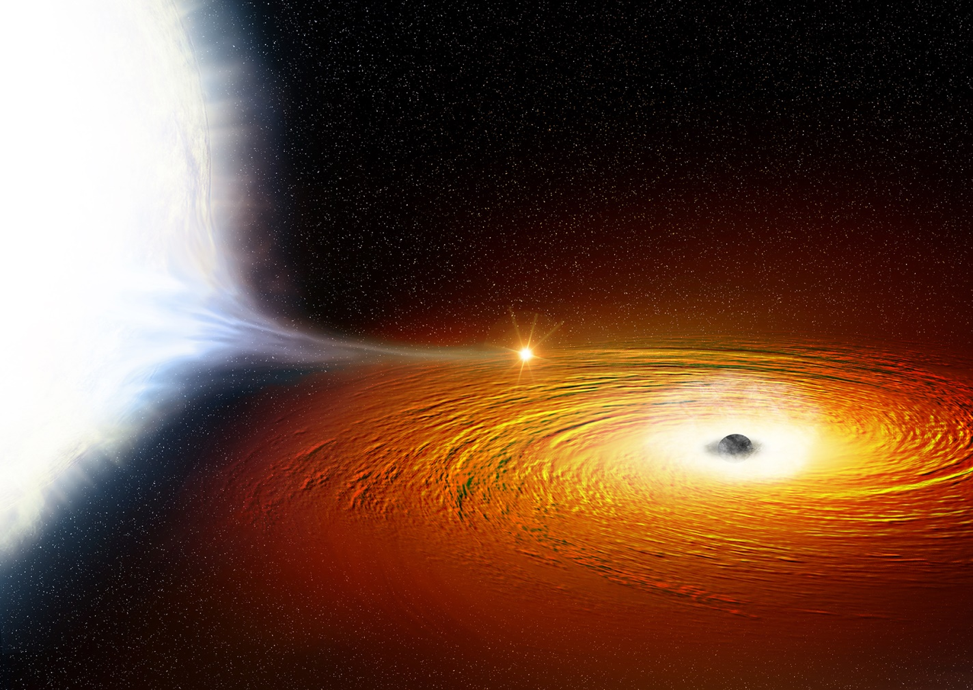
National Science Olympiad
Astronomy C Event 2019
Stellar Evolution in Normal & Starburst Galaxies
Supported by NASA’s Universe of Learning STEM Network
Notes:
This presentation is an overview of the content and resources for the National Science Olympiad (NSO) Division C 2019 Astronomy event. The NSO 2019 national competition will be held at Cornell University in Ithaca, NY on May 31st – June 1st.
http://cornellscioly.com/

Slide 2
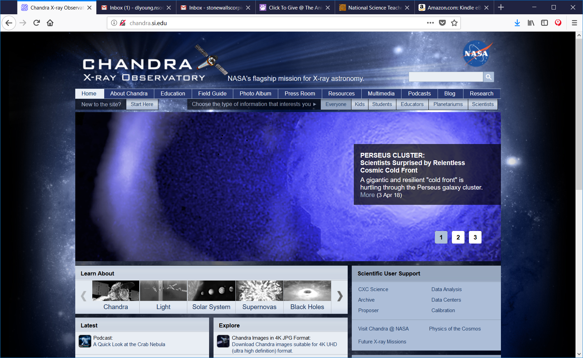
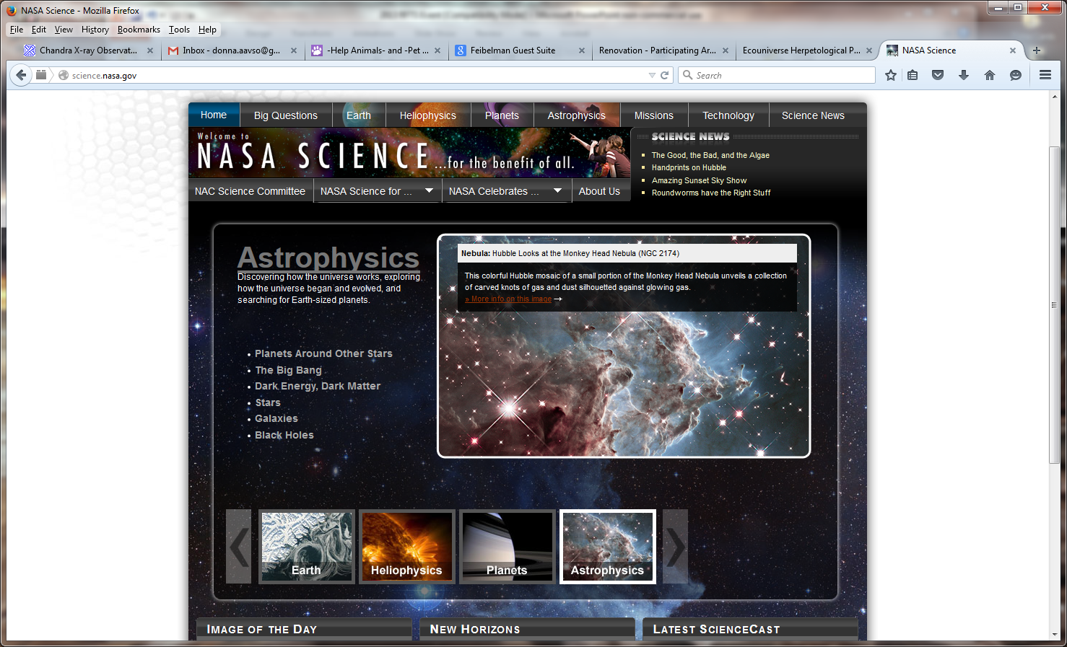
NASA’s Universe of Learning Network/CXC/NSO
dlyoung.nso@gmail.com
Notes:
The Astronomy event is supported by NASA’s Astrophysics Division Universe of Learning STEM Literacy Outreach program via the Chandra X-Ray Observatory mission. The Chandra website has several educational products designed for Science Olympiad team members to learn about stellar evolution and other topics associated with the Astronomy event, including a webinar.
http://science.nasa.gov/astrophysics/
http://chandra.harvard.edu/

Slide 3
Outline
Event Description, 2019
Where to start?
Distance calculations
Deep Sky Objects (DSOs)
Resources

Slide 4
ASTRONOMY, Division C
DESCRIPTION: Teams will demonstrate an understanding of stellar evolution
in normal and starburst galaxies
A TEAM OF UP TO: 2 APPROXIMATE
TIME: 50 minutes
EVENT PARAMETERS: Each team may bring two computers (of any kind), two 3-ring binders (any size) containing information in any form from any source, or one computer and one 3-ring binder. The materials must be inserted into the rings (notebook sleeves are permitted). Each team member is permitted to bring a programmable calculator. No internet access is allowed; however teams may be accessing a dedicated NASA data base.
Notes:
The Astronomy event content focus for 2019 is stellar evolution in normal and starburst galaxies. Each team MUST bring one computer (of any kind), and either a 3-ring binder or another computer. General internet access is not allowed; however, teams will be accessing a dedicated NASA data archive.
http://store.soinc.org/c-2-k-12-rules-manuals.aspx

Slide 5
Using information which may include Hertzsprung-Russell diagrams, spectra, light curves, motions, cosmological distance equations and relationships, stellar magnitudes and classification, multi-wavelength images (X-ray, UV, optical, IR, radio), charts, graphs, animations and JS9 imaging analysis software, teams will complete activities and answer questions relating to:
͏Stellar evolution, including stellar classification, spectral features and chemical composition, luminosity, blackbody radiation, color index and H-R diagram transitions, star formation, Cepheids, RR Lyrae stars, Type Ia & Type II supernovas, neutron stars, pulsars, stellar mass black holes, supermassive black holes, X-ray & gamma-ray binary systems, ultraluminous, X-ray sources (ULXs), globular clusters, stellar populations in normal & starburst galaxies, galactic structure and interactions, gravitational waves.
Use Kepler’s laws, rotation and circular motion to answer questions relating to the orbital motions of binary systems and galaxies; use parallax, spectroscopic parallax, the distance modulus, the period-luminosity relationship, Hubble’s law, and the Tully-Fisher relationship to calculate distances.
Identify and answer questions relating to the content areas outlined above for the following objects: M51/NGC 5195, IC 10, SPT 0346-52, M81/M82, SN2014J, Phoenix Cluster, NGC 4993, 47 Tucanae/X9, Chandra Deep Field South, Cen A, M100, Abell 400/NGC 1128 & 3C 75, Antannae Galaxies, ESO 137-001, Sagittarius A*
Notes:
The event description for the 2019 competition includes the most important properties and characteristics related to the evolution of massive stars. The motions of binary systems, galaxies and interacting galaxies are important as these motions result in bursts of extreme star formation. Kepler’s laws, the period-luminosity relationship, Hubble’s law and the Tully-Fisher relationship are useful for determining motions, velocity and distances. The 15 deep sky objects (DSOs) include an assortment of galaxies and other objects associated with accelerated star formation.
The competition focus for 2017 was Stellar Evolution and Type Ia Supernovas, and the focus for 2018 is Stellar Evolution and Type II Supernovas. Team members who have competed those two years have a basic understanding of the process of how stars form and evolve over time into their final end products. Those team members will have an edge for the 2019 competition year. Because of some teams having an advantage, as well as the addition of galaxies which is a new focus, the topic of Stellar Evolution in Normal and Starburst Galaxies will be repeated for the 2020 competition. Only the DSOs will change.
http://store.soinc.org/c-2-k-12-rules-manuals.aspx

Slide 6
Outline
Event Description, 2019
Where to start?
Distance calculations
Deep Sky Objects (DSOs)
Resources

Slide 7
Stars
Almost everything in astronomy relates back to stars.
So, should study their properties
Best done by understanding the HR diagram!
Will go over HR diagram basics – how to interpret
Stellar evolution

Slide 8
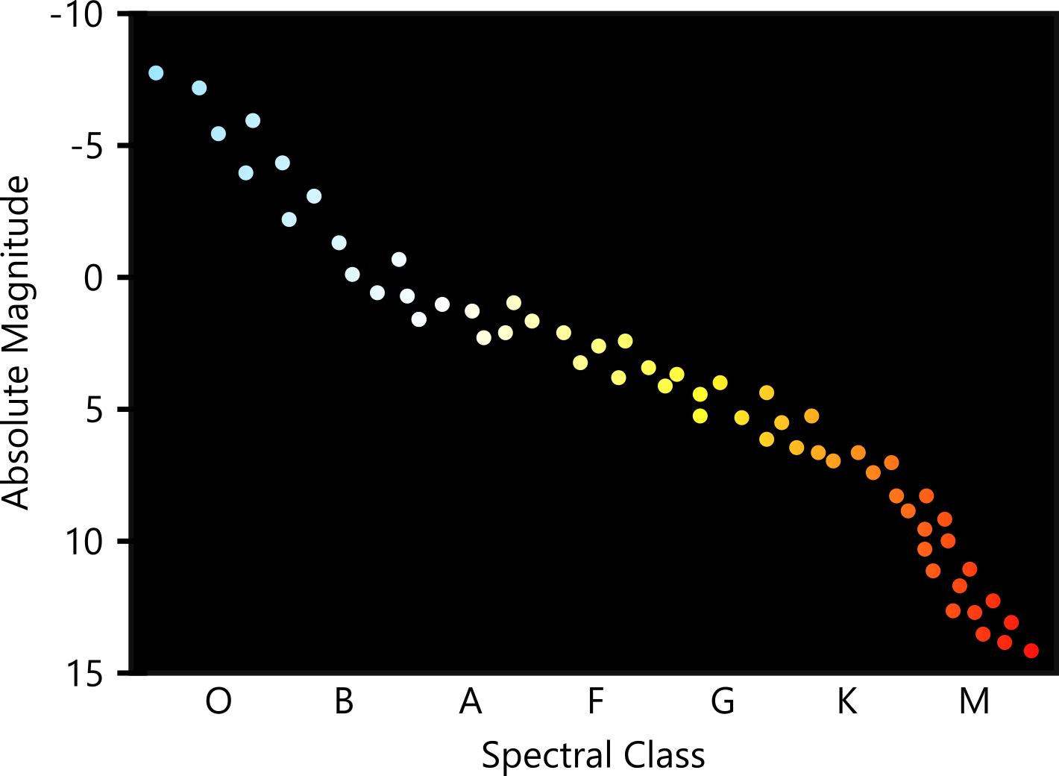
Notes:
The HR diagram is an indispensable tool for understanding the varieties of stars we observe. The first such diagrams were created by Russell in the early 1900s, and very roughly plotted a star’s spectral type against its intrinsic brightness (a.k.a absolute magnitude). The spectral type (or spectral class) can be thought of as roughly corresponding to the color of a star. Surprisingly, there is a correlation: bluer stars, for the most part, are intrinsically more bright than red stars. There were a few outliers which are not shown in the diagram above – we’ll see later that these outliers are actually stars in their death throes. The stars shown above are all “healthy adult” stars – in astronomy, we call them “main sequence” stars.
Diagram created by Dhruva Karkada.

Slide 9
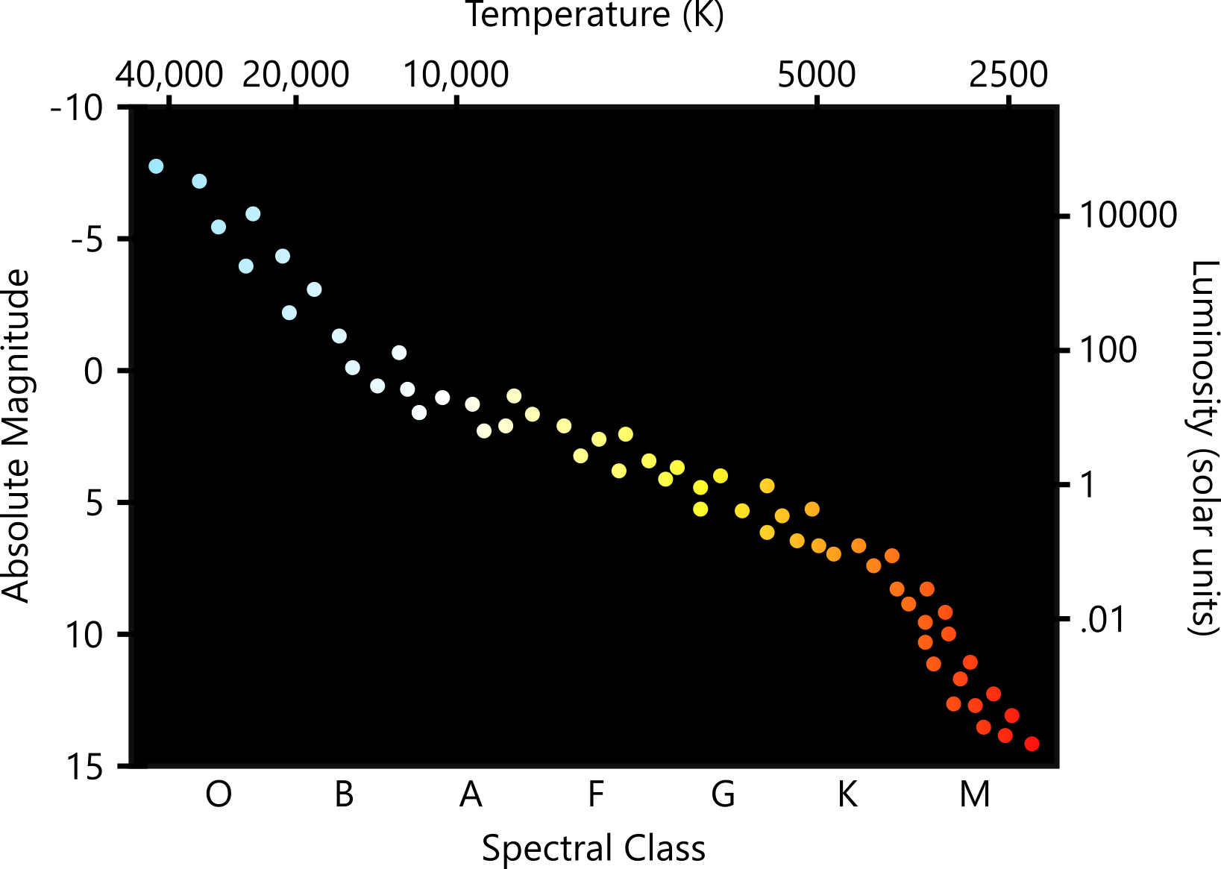
Notes:
Think about heating up a metal, like the coil of an electric stove. At first, it doesn’t emit any light, but as it gets hotter, it glows red, then orange. If you kept going, it would eventually glow yellow, white, and then a light blue. This corresponds to the colors we see in stars! This means that a star’s color is actually directly related to how hot it is. This is the central idea behind blackbody radiation.
We can also replace the units for the intrinsic brightness – instead of using the unintuitive magnitude scale, we can express luminosity in units of the sun’s luminosity.
Of course, stars (unlike stoves) are not powered by electricity: they get their heat from nuclear reactions in their core. In many ways, the core of a star is like an engine: it “burns” fuel to produce energy.
Keep in mind that the temperatures on the HR diagram represent the temperature at the surface of the star. The cores of stars are MUCH hotter than the surface temperature.
Diagram created by Dhruva Karkada.

Slide 10
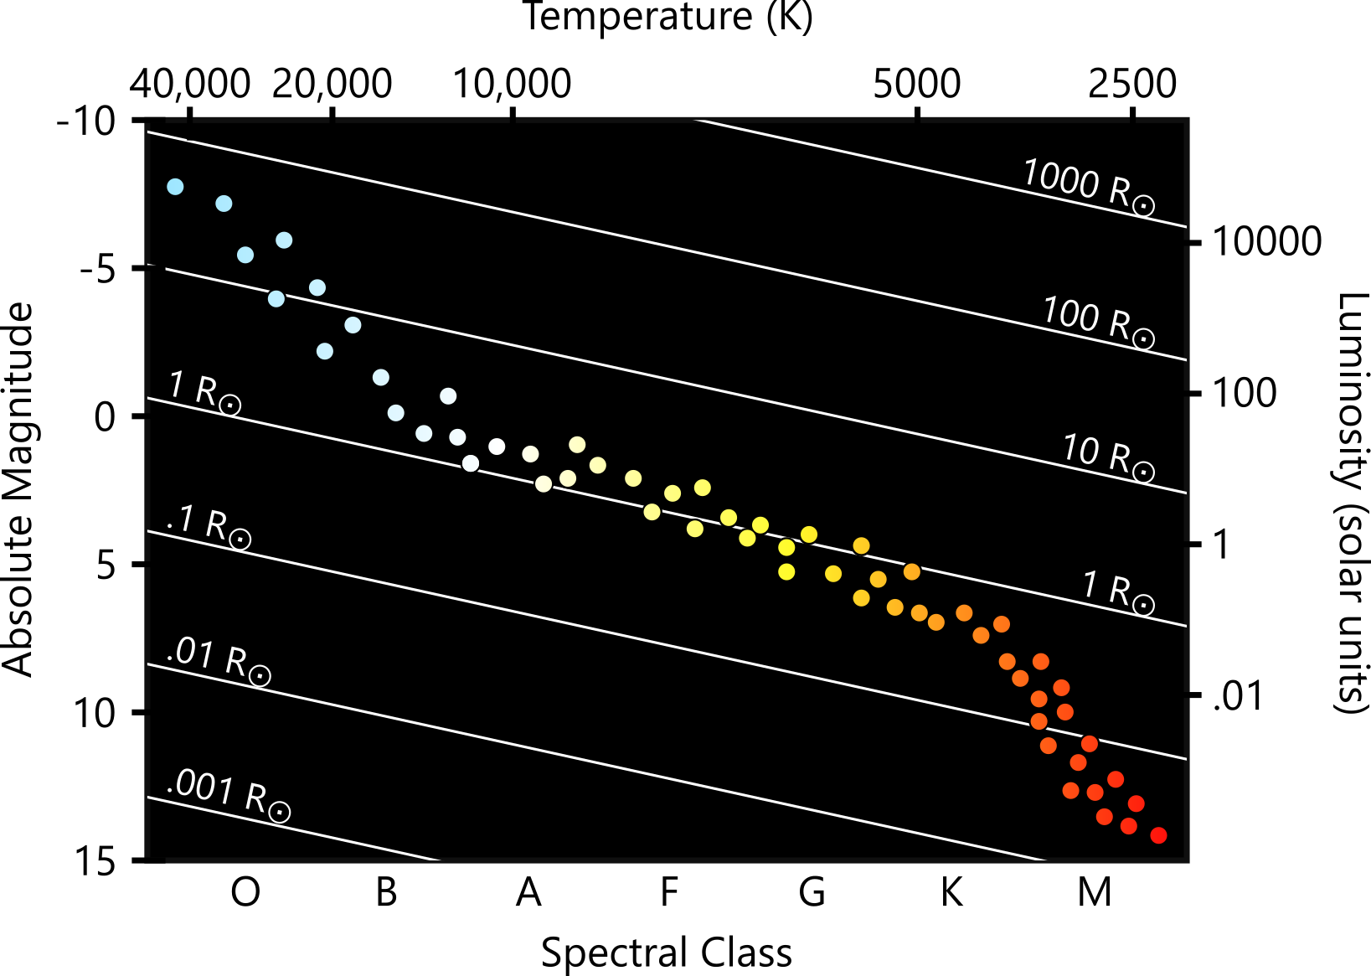

$$L∝R^{2}T^{4}$$
Notes:
There’s more! Now that we know surface temperature and brightness, we can also calculate, using the Stefan-Boltzmann law, the size of stars. Clearly, these blue stars are not only hotter than the red stars, but they’re also much bigger! As you might expect, this also means that the big, hot, blue stars are more massive – they contain much more gas than small red stars. It’s not shown on this diagram, but B-type stars are somewhere around 30 times as massive as the sun (30 solar masses), while the very largest O type stars are around 100 solar masses. The dimmest type M stars are about a tenth of a solar mass.
As it turns out, their size is the reason for their temperature: large stars burn fuel way faster, and they get very hot. Even though they have more fuel (since they’re more massive), the rate at which they burn it is so much higher that they run out of fuel much sooner than low-mass stars. As a result, massive stars have a much shorter lifespan than dim stars. Think about a gas-guzzling pickup truck versus a sedan with good fuel economy: even though the sedan might have a smaller gas tank, it’ll last longer between refuels than the truck.
So, for main sequence stars, we’ve found out that a bunch of different properties are actually strongly correlated: size, mass, temperature, and brightness. But what about dying stars that are not on the main sequence?
Diagram created by Dhruva Karkada.

Slide 11
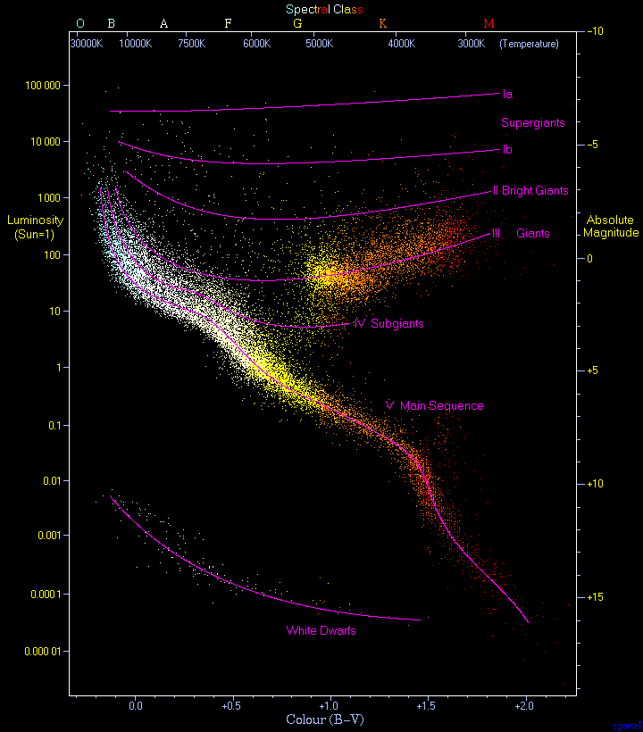
Notes:
Here’s a common picture of the HR diagram which you can find by a quick Google search. The main sequence contains most of the stars, but there are clearly many stars which aren’t on the main sequence. What’s the deal with those?
Any star that is not on the main sequence is not a healthy, adult star. All those outlier stars are in the process of dying: several million years ago, those stars WERE on the main sequence. But as stars run out of fuel, they go through dramatic changes, which typically involve cooling down and inflating like a giant balloon. This combination of decreasing temperature and increasing size means that stars in their old age will drift towards the top right, which is exactly what we see.
The process of approaching death (and the process of death itself) varies pretty significantly depending on the initial mass of the star. When it comes to stellar evolution, the most important predicting factor is the mass of the star. I’ll give an example with the sun.
Image from Wikipedia.

Slide 12
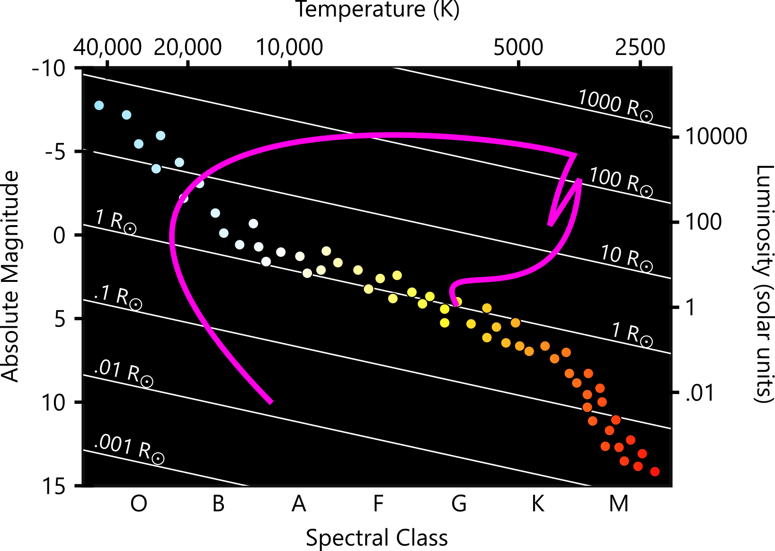
Notes:
The evolutionary path of the sun (and stars similar to it). Note that the sun doesn’t spend equal amounts of time in equal segments along this path. In fact, the next 4.5 billion years are spent in the tiny stretch before the first bend, still on the main sequence. The rest of the path happens in about a billion years; the last curve (the really big one) is traversed in just 10,000 years. As expected, the future evolution of the sun will, very roughly, involve a cool down and expansion into a red giant. The last curve is the final stage of the sun’s evolution: the sun blows off most of its atmosphere, leaving a hot but small core – a white dwarf.
The white dwarf is a stellar corpse, but is not the only kind of stellar remnant. Neutron stars and black holes are formed when much more massive stars die, and these stellar remnants are prominently featured in this year’s topics. I also neglected to mention other important topics such as stellar pulsation, and how that fits into the HR diagram (the instability strip).
Image created by Dhruva Karkada

Slide 13
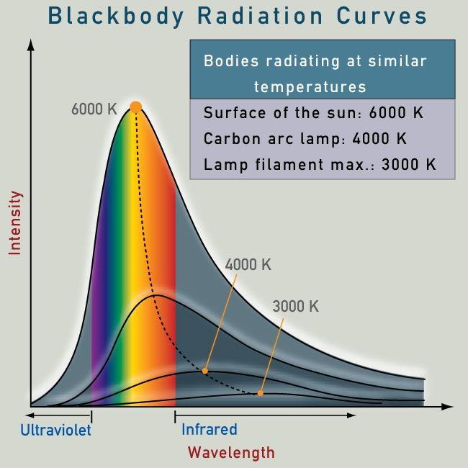
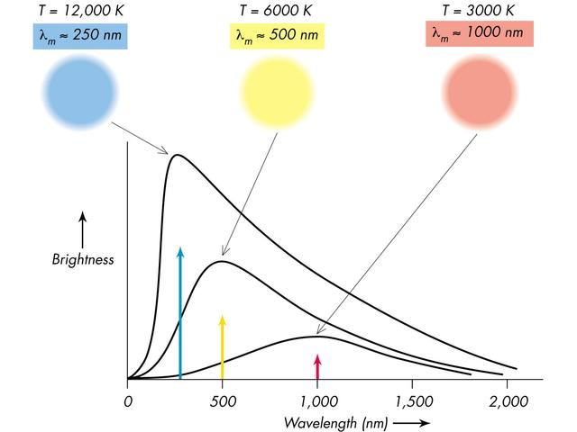
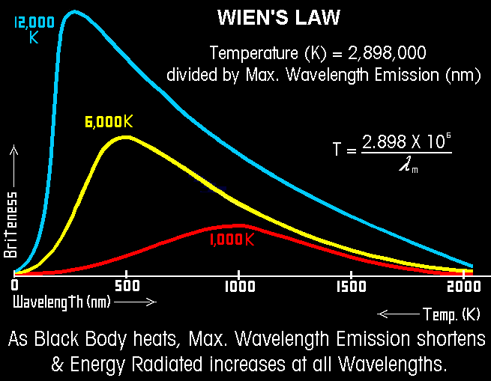
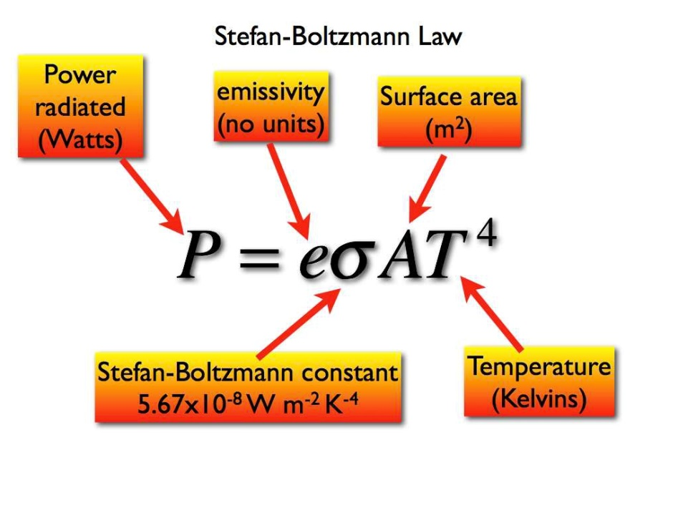
Radiation Laws
Planck’s Law
(λ_{max} = 2.9 x 10⁶ /T)
Notes:
The stellar radiation laws and blackbody radiation have been a part of every past Astronomy event as they explain basic physical properties fundamental to all stars. A blackbody is an artificial construct that absorbs all radiation it receives and then emits it all away – everything that comes in goes out. Stellar atmospheres are very good approximations of blackbody radiators, absorbing radiation produced by the core and emitting it out into the interstellar medium. The hotter the star the more energy it emits at every single wavelength than a cooler star. The graphic shows a 12,000K star, a 6,000K star and a 3,000K star and nowhere does the 3,000K star emit more radiation at any wavelength than the two hotter stars. That principle is called Planck’s Law. Wien’s Law states the maximum radiation that comes from any star or blackbody has a peak with a specific temperature and corresponding wavelength. The mathematical relationship is used to determine the temperature and/or wavelength of stellar objects. The Stefan-Boltzmann Law shows that the area beneath the curve is equal to the total power of the star and is related to the temperature and area of the star.
http://astronomy.swin.edu.au/cosmos/B/Blackbody+Radiation
http://www.pas.rochester.edu/~blackman/ast104/radiation.html

Slide 14
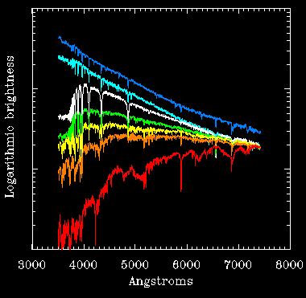
Spectra
Notes:
The two spectra at the top right – the image above and the corresponding plot below is a WN – Wolf-Rayet emission spectra showing the broad nitrogen emission line. The other images show spectral plots – wavy lines with dips to show where absorption is happening. Stars are classified by their spectra – and their spectral classification depends on their temperature. Spectral plots are more useful than images for scientific measurements. Hydrogen Balmer lines and the Fraunhoffer lines from other elements are used for classification and each stellar temperature has a unique set of absorption spectra.
https://en.wikipedia.org/wiki/Stellar_classification

Slide 15
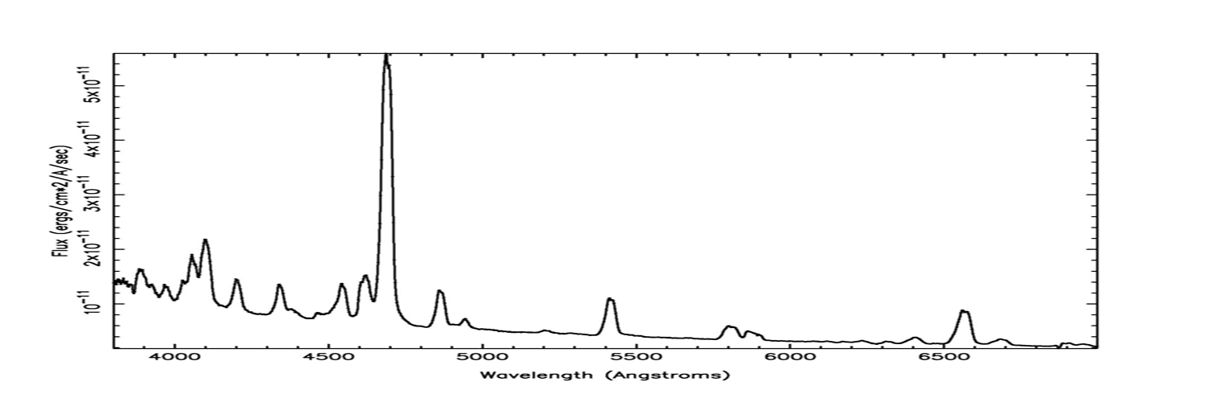
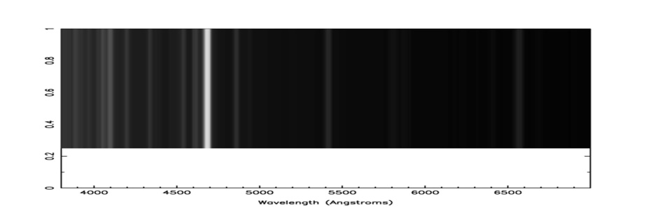
Spectra
Notes:
The two spectra at the top right – the image above and the corresponding plot below is a WN – Wolf-Rayet emission spectra showing the broad nitrogen emission line. The other images show spectral plots – wavy lines with dips to show where absorption is happening. Stars are classified by their spectra – and their spectral classification depends on their temperature. Spectral plots are more useful than images for scientific measurements. Hydrogen Balmer lines and the Fraunhoffer lines from other elements are used for classification and each stellar temperature has a unique set of absorption spectra.
https://en.wikipedia.org/wiki/Stellar_classification

Slide 16
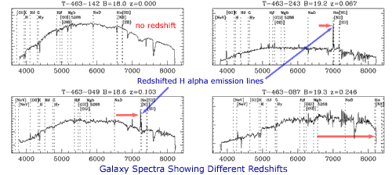
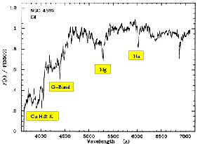
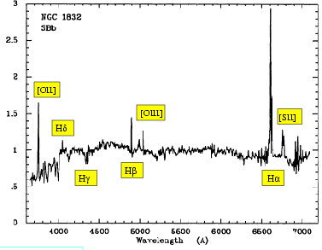
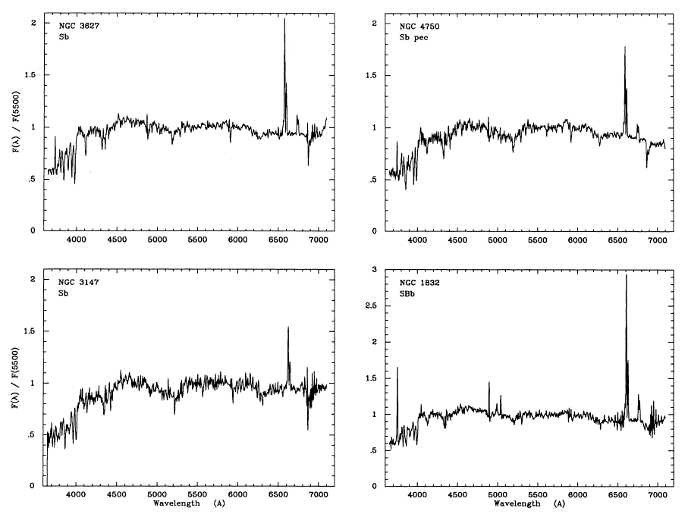
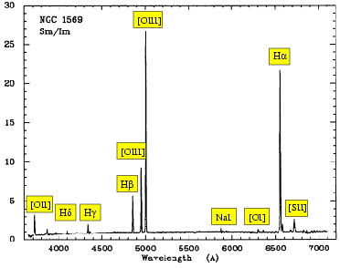
Galactic Spectra
Spirals - Redshift
Elliptical
Spirals
Irregular
Notes:
The overall spectrum of a galaxy is simply the combined spectrum of all the stars and other radiating matter in the galaxy. As galaxies vary in structure and relative composition of star type and gas their spectra will vary. Examples of galactic spectra obtained by the 2dF Galaxy Redshift Survey are shown on the slide. Note the differing redshifts of the galaxies. The top left galaxy is at zero redshift whilst the bottom right one has a redshift of z = 0.246. The other two galaxies show prominent Hα emission lines suggesting active star formation in them. These Hα lines have been redshifted beyond the rest frame value of 6563 Ångstroms.
Obtaining a spectrum from a galaxy rather than a star differs in that the galaxy can often be resolved as an extended rather than a point-source object. For a galaxy that appears extended it is possible to take a spectrum from different parts of the galaxy. This can provide information such as the composition, star birth rates and the rotational velocity for different parts of the galaxy.
http://www.atnf.csiro.au/outreach/education/senior/astrophysics/spectra_astro_types.html

Slide 17
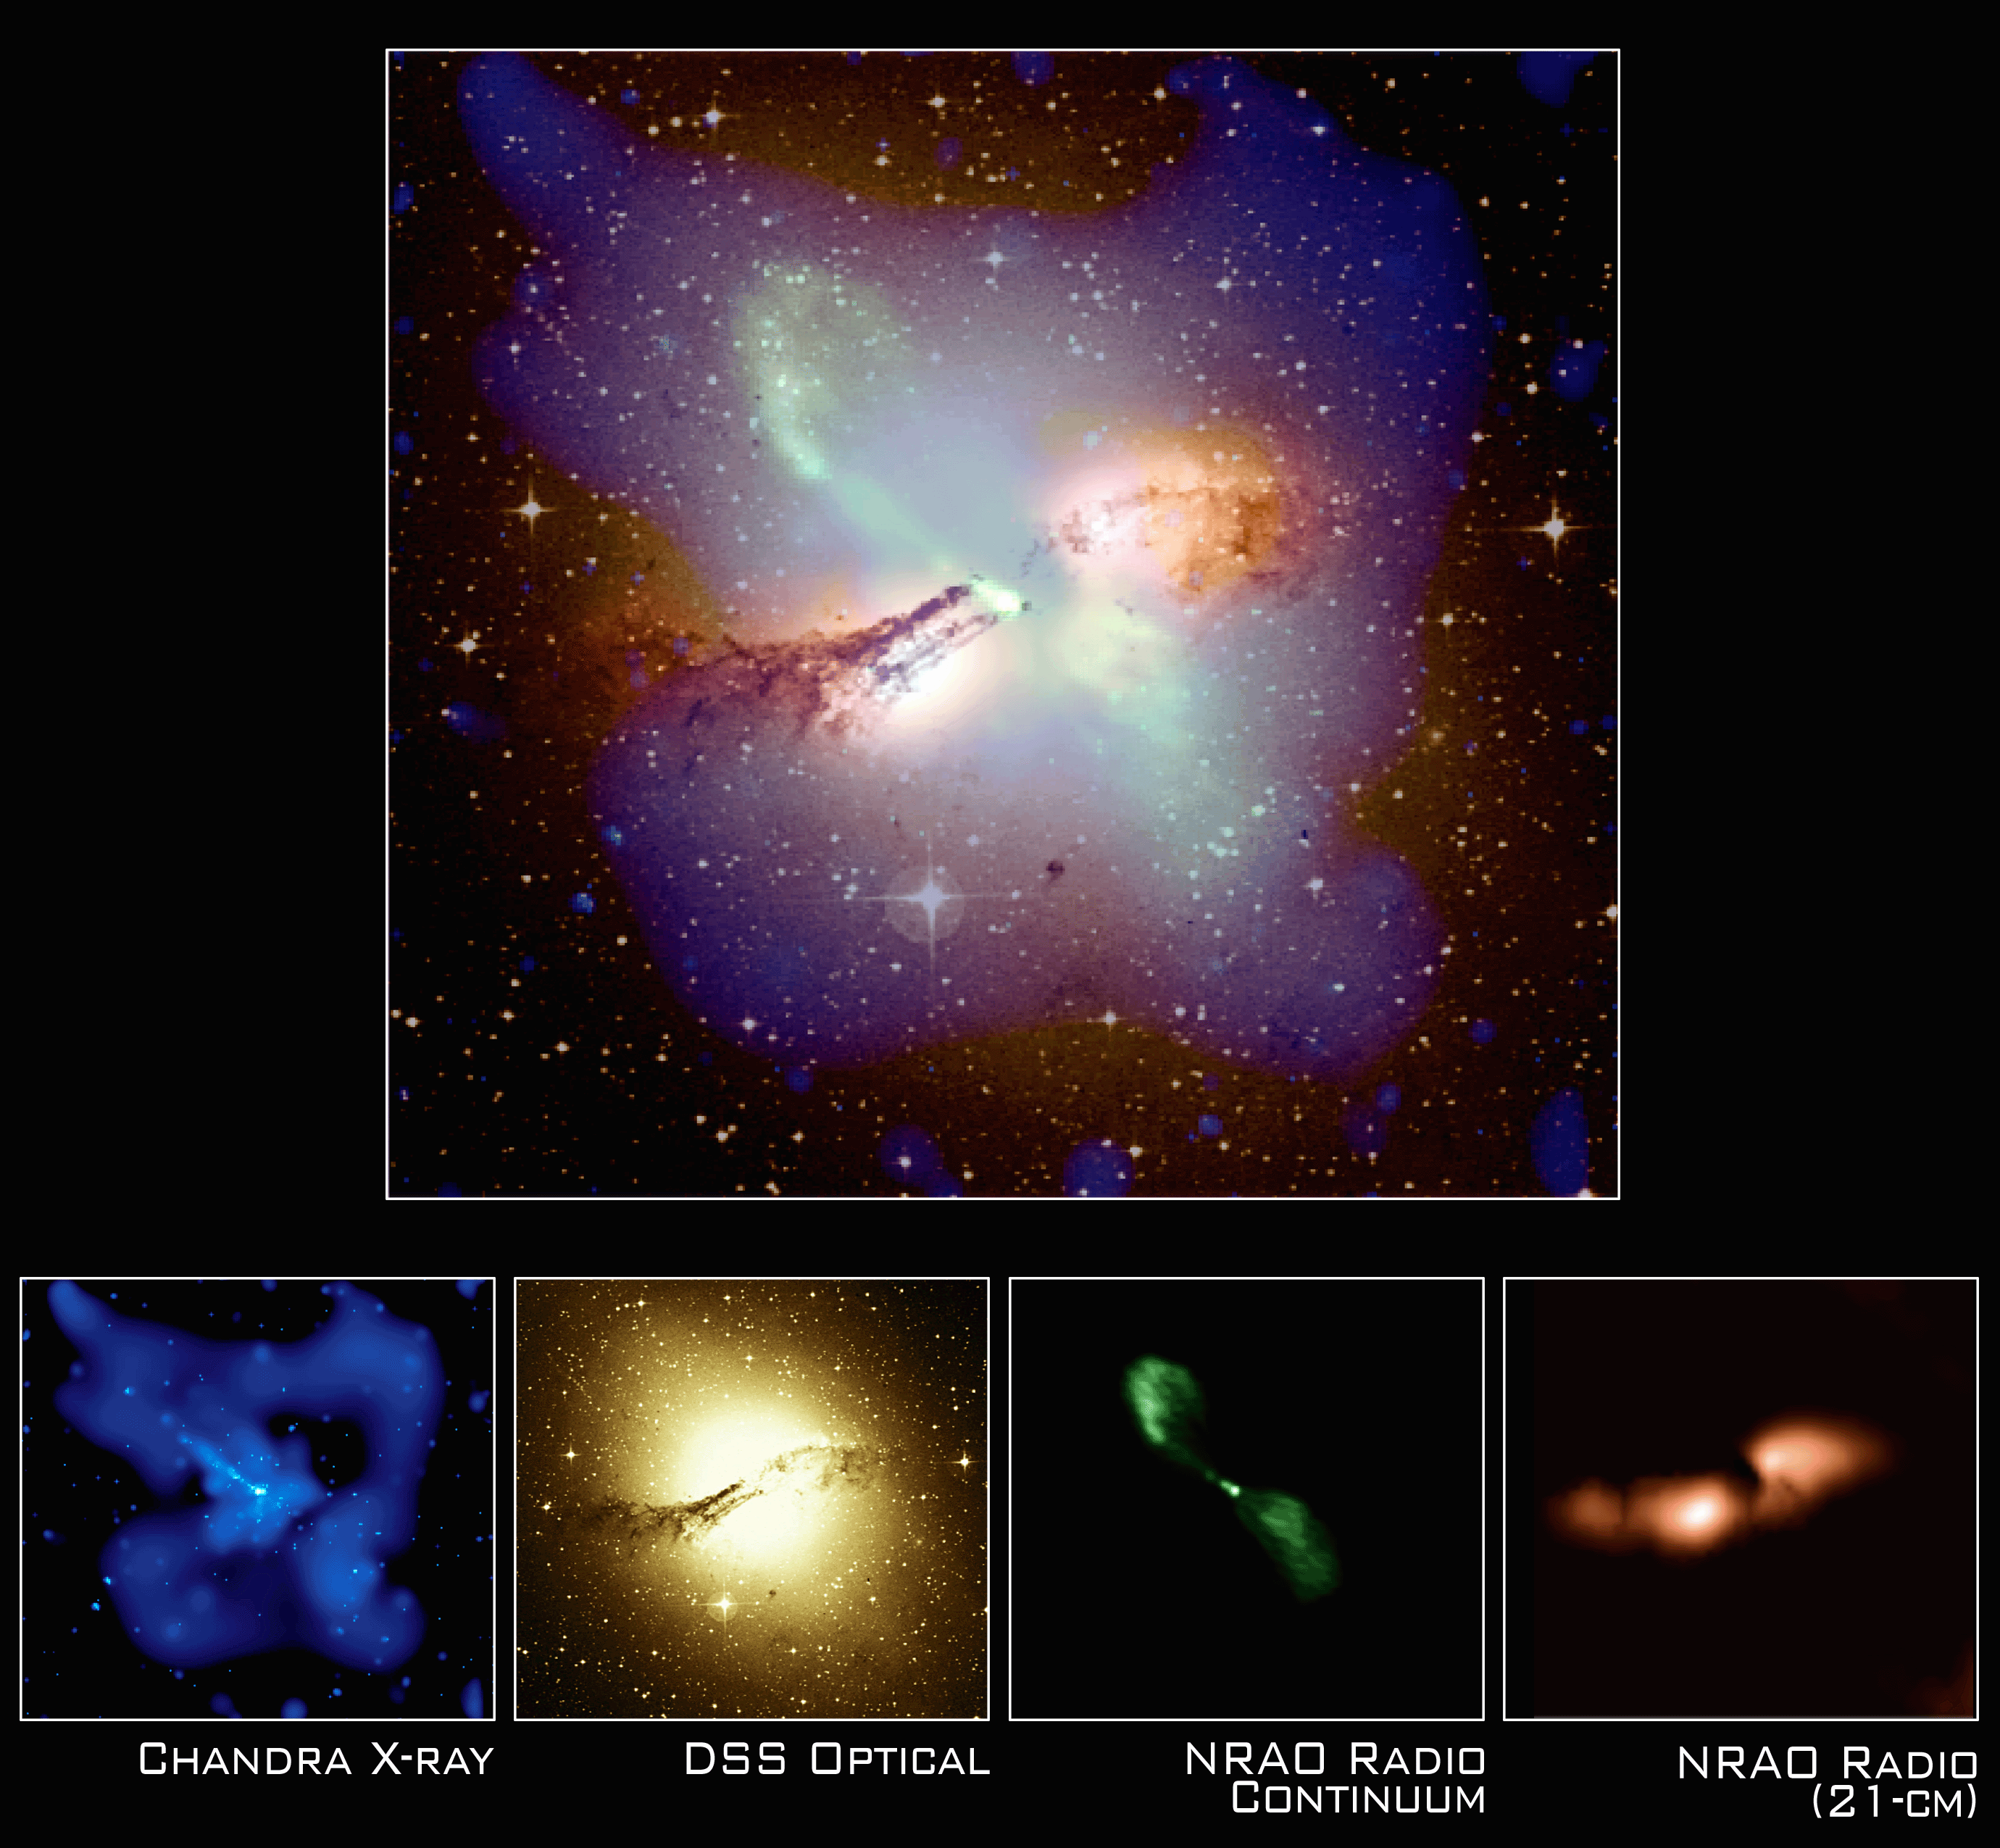
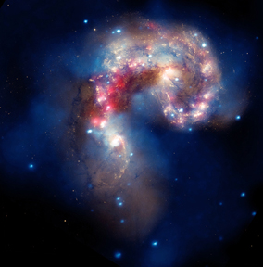
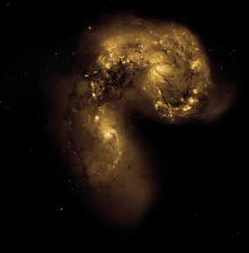
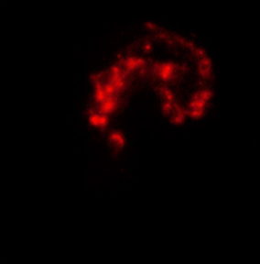
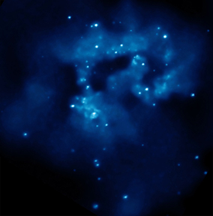
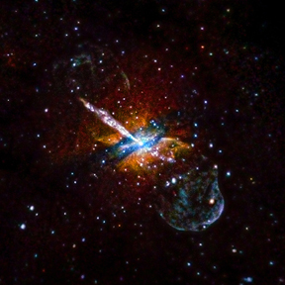
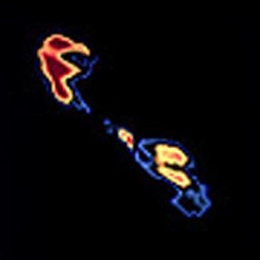
Multiwavelength Universe
Cen A
Antennae
Composite
Optical
IR
X-Ray
X-Ray
Radio
Notes:
It is important to be able to recognize the deep sky objects as they have been observed across the electromagnetic spectrum. Each band of the spectrum – Radio, IR, Optical, UV, X-ray, and Gamma – is produced by a different process. Some DSOs emit mostly X-ray radiation and can barely be detected in other wavelengths. Stars and other objects look very different when imaged in different parts of the spectrum and teams should be familiar with images of the DSOs in all wavelengths. M100 is one of the examples.
http://coolcosmos.ipac.caltech.edu/cosmic_classroom/multiwavelength_astronomy/multiwavelength_astronomy/observing.html
http://coolcosmos.ipac.caltech.edu/cosmic_classroom/multiwavelength_astronomy/multiwavelength_museum/gallery.html

Slide 18
Outline
Event Description, 2019
Where to start?
Distance calculations
Deep Sky Objects (DSOs)
Resources

Slide 19
Figuring out distance
It’s pretty hard to figure out how far away something is by just looking at it
Knowing distance is extremely useful!
Use different techniques to try to determine distance
Parallax
Pulsating stars
Binary stars
Redshift of galaxies
Etc…

Slide 20
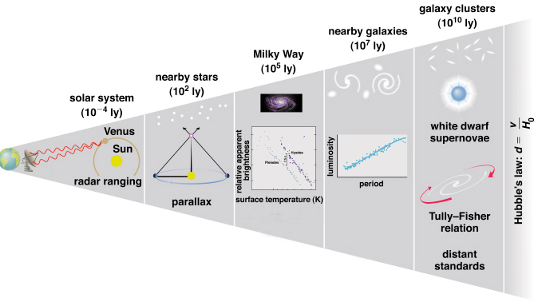
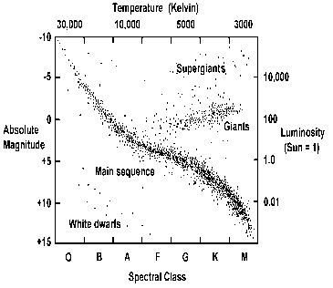
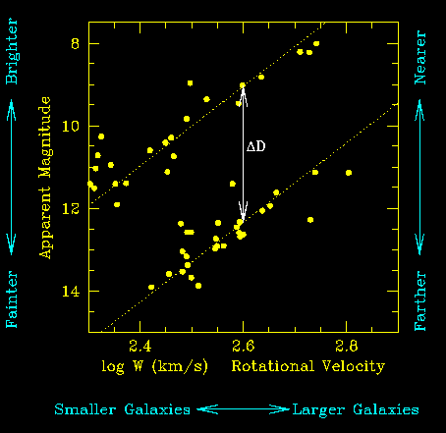
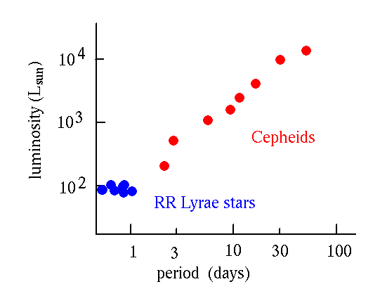
Cepheids
Type Ia
Supernovas
Period-Luminosity
Relationship
Spectroscopic
Parallax and/or
Main Sequence Fitting
RR Lyrae
Relationship between mass or intrinsic luminosity of a spiral galaxy
and its angular velocity or emission line width… L~V⁴
Notes:
Different methods are used to measure cosmological distances depending on how distant the objects are from Earth. Distances to individual stellar objects within the MWG can be determined by acquiring the spectrum of the object, and main sequence fitting works for groups of stars – open clusters and globular clusters. More distant galaxies can be measured using the light curves of Cepheids and RR Lyrae pulsating variable stars, the distance modulus and the period-luminosity relationship. Galaxy cluster distances can be calculated using Type Ia supernovas – again with the distance modulus as the source of a Type Ia supernova is the destruction of a white dwarf and they are nearly the same mass. The Tully-Fisher relation can be used to calculate distances to galaxy clusters also as the luminosity is proportional to its angular emission line width or angular velocity to the 4th power. Even more distance distances to galaxies are calculated by Hubble’s law that states distance is related to recessional velocity divided by the Hubble constant.
https://www.noao.edu/staff/shoko/tf.html
https://en.wikipedia.org/wiki/Tully%E2%80%93Fisher_relation

Slide 21

A USEFUL INTERMEDIARY
The intrinsic brightness – compare with observed brightness
Lighthouse: dim means far, seems brighter when near
Only works if intrinsic brightness is known (imagine a captain who has never heard of a lighthouse)
Assumption: there is no interstellar gas in the way
Otherwise: dim lighthouse = far away, or too much fog?
Usually a safe assumption
$$m−M=5\log_{10}{d}−5$$
Notes:
A common way to figure out distance to a luminous object is to figure out its intrinsic brightness. If we know that, we can observe the apparent (measured) brightness and compare to figure out how far it is (using the distance modulus). As an analogy: a ship captain who knows how bright a lighthouse is can tell how far they are from it based on how dim it looks. But if he/she had no idea how bright a lighthouse is supposed to be, how can he/she make any kind of estimation?
This rests on the assumption that there’s no fog! If there’s something blocking the light, all bets are off. In astronomy, when light is blocked by intervening gas, it’s called extinction. Usually we can get away with assuming that extinction is negligible.
So now we shift the question: how to we figure out how intrinsically bright an object is?

Slide 22
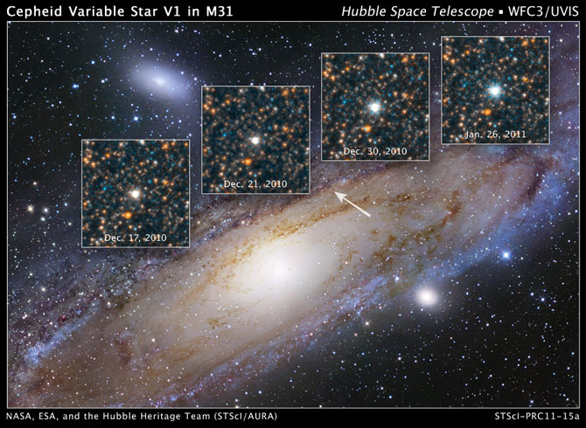
Notes:
This image shows V1 – the first Cepheid variable used by Hubble to calculate the distance to M31 and showed that those little spiral nebulas were outside the MWG and the universe became a very large place! The period of a Cepheid variable can be calculated using its light curve – the plot of the change in brightness over time. The period can then be used to apply the period-luminosity relationship which gives the luminosity. Since there is a relationship between luminosity and absolute magnitude, the absolute magnitude can be determined and used with the distance modulus to calculate the distance to the Cepheid variable star.
http://www.atnf.csiro.au/outreach/education/senior/astrophysics/variable_cepheids.html

Slide 23
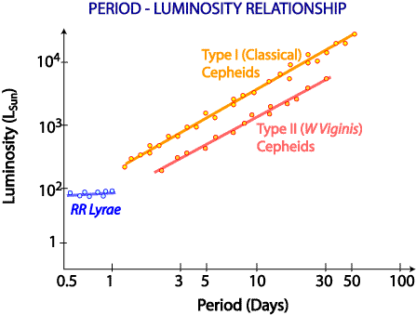
Notes:
As mentioned above, Cepheids are periodically pulsating variable stars with an identifiable light curve type. There is a relationship between the luminosity of a Cepheid and its period – the longer the period the greater the luminosity. By observing the change in brightness over time as it pulsates and plotting the apparent brightness versus time, its luminosity can be determined. Using the relationship of luminosity to absolute magnitude, the absolute and apparent magnitudes can be used with the distance modulus to determine the distance to the Cepheid. There are two types of Cepheids remember – the Type I high-metallicity younger stars (Classical) and the Type II low-metallicity older stars (W Virginis). The period luminosity relationship of the two types of Cepheids is off-set from each other with the Type I being more luminous. The RR Lyrae pulsations have very little variation and their luminosity and period changes are insignificant.
http://www.astronomynotes.com/ismnotes/s5.htm

Slide 24
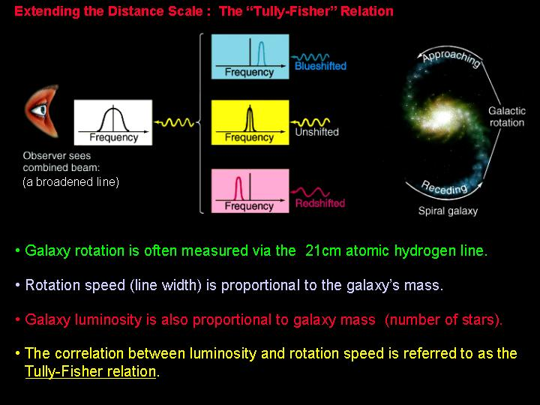
Notes:
The Tully-Fisher relationship as previously stated is a correlation between the luminosity and rotational speed of a galaxy. The rotational velocity is measured using the 21cm broadened atomic hydrogen line. The rotational velocity as well as the luminosity is proportional to the galaxy’s mass (number of stars); however, the Tully-Fisher relation is the correlation between luminosity and rotational velocity.
https://en.wikipedia.org/wiki/Tully%E2%80%93Fisher_relation
https://www.astro.ufl.edu/~guzman/ast1002/class_notes/Ch15/Ch15.html

Slide 25
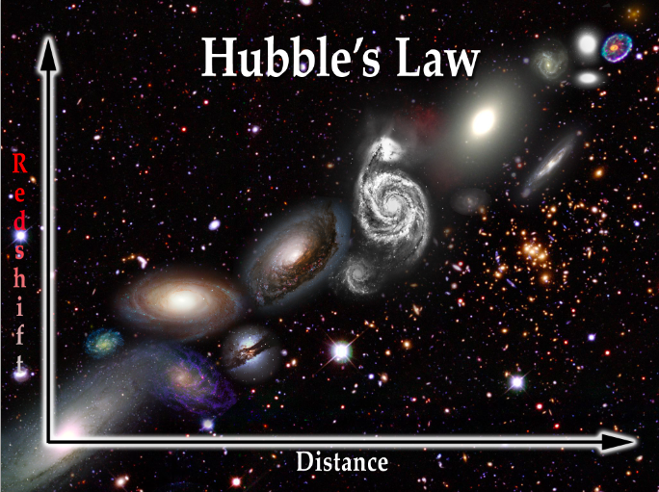
V = H₀d
Notes:
Hubble’s law shows a direct correlation between the distance to a galaxy and its recessional velocity. The Hubble constant is thought to be 70km/s/Mpc though it has changed several times over the years. The relationship is determined by measuring the red shift of galaxies and the further away a galaxy the faster it is receding from us. No matter where in the universe you are located, you would see the same effect – all galaxies are receding from your location.
http://hyperphysics.phy-astr.gsu.edu/hbase/astro/hubble.html

Slide 26
Outline
Event Description, 2019
Where to start?
Distance calculations
Deep Sky Objects (DSOs)
Resources

Slide 27
Deep Sky Objects
A. Galaxies:
IC 10 Starburst Galaxy
SPT 0346-52 Starburst Galaxy
Centaurus A (Cen A) Active Starburst Colliding Galaxies
M81/M82 (Cigar Galaxy) Normal/Starburst Galaxies/Interacted
M51 (Whirlpool/NGC 5194 Interacting Galaxy Pair & NGC 5195)
M100 (NGC 4321) Spiral Galaxy
Antennae (NGC 4038 Colliding Galaxies & NGC 4039)
ESO 137-001 Runaway Galaxy in Norma Cluster
NGC 4993/GW170817 Galaxy & Gravitational Wave
B. Other:
Phoenix Cluster Galaxy Cluster
ABELL 400/NGC 1128 & 3C 75 Galaxy Cluster, Binary Black Hole
SN 2014J Type Ia Supernova in M82
47 tucanae (NGS 104) & X9 Globular Cluster/Black Hole
Sagittarius A* Milky Way Galaxy Black Hole
Chandra Deep Field South Deepest X-Ray Image Ever
Notes:
This slide arranges the deep sky objects (DSOs) into two groups: Group A is a list of 9 galaxies – including starburst, interacting and colliding galaxies. Group B includes 2 galaxy clusters, a globular cluster, a Type Ia supernova located in one of the galaxies from Group A, the black hole in the center of the Milky Way Galaxy (MWG) and the Chandra Deep Field South – the deepest X-Ray image ever collected (one million second observation over a 6-week period).

Slide 28
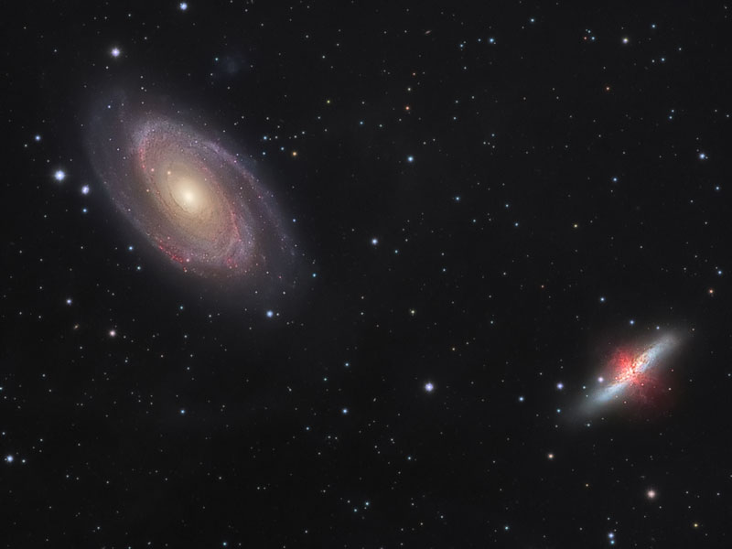
M81 & M82 – Interacting Galaxies
Notes:
This view shows the grand design spiral galaxy M81 and irregular galaxy M82. These two galaxies are gravitationally bound together and have had a huge effect on each other with each 100 million-year pass over the last billion years. M82 has produced density waves in M81 that has resulted in star formation within the galactic disk. M82, while the effect of M81 on M82 has produced violent star formation regions and gas clouds colliding so violently that the galaxy glows in X-rays.
https://apod.nasa.gov/apod/ap130925.html

Slide 29
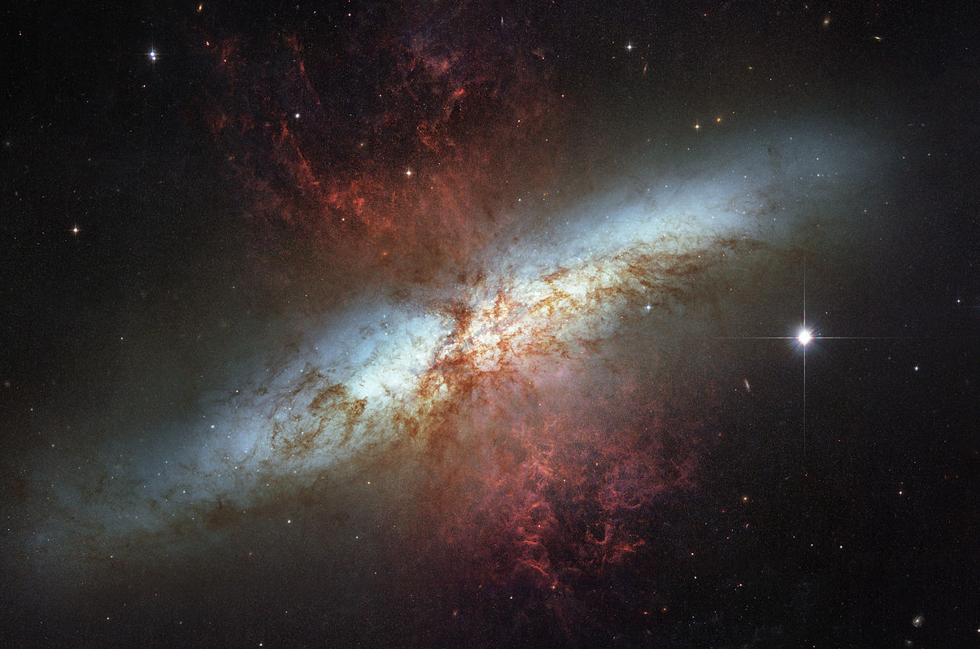
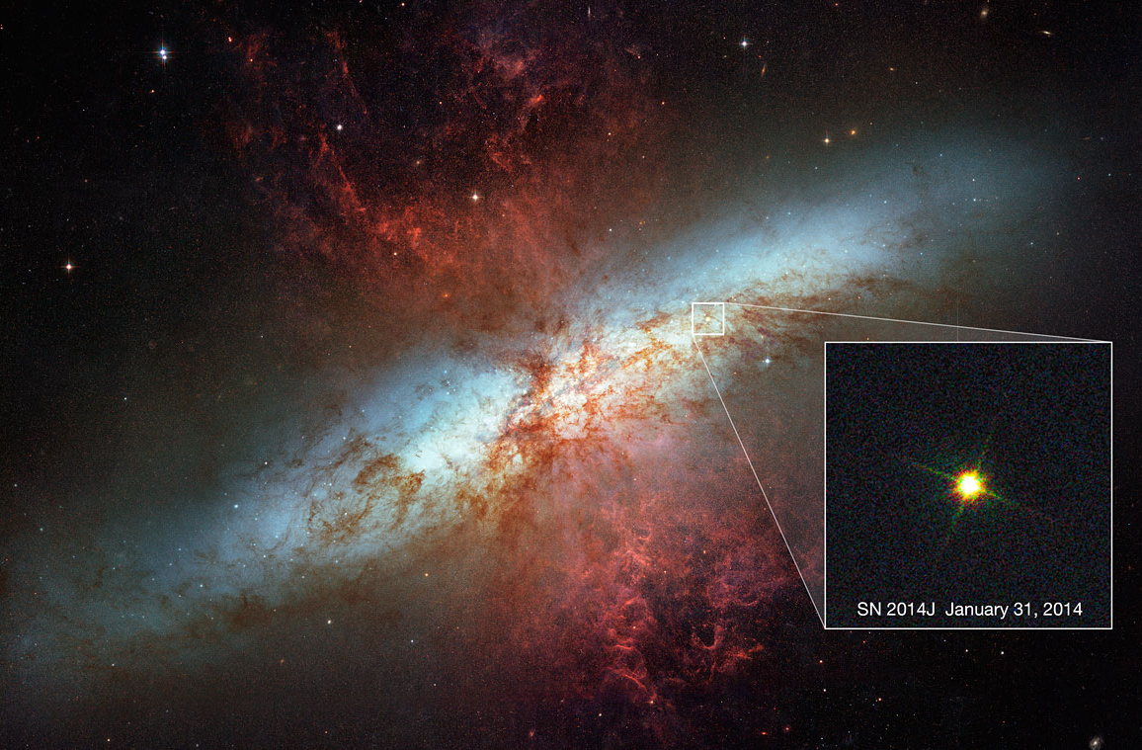
SN 2014J
Notes:
SN 2014J is the Type Ia supernova located within the starburst galaxy M82. It is 12 million Ly away, making it the closest optical supernova within the past 20 years and potentially during the timeframe of currently operating missions. This event is interesting because the Chandra mission did not detect any X-ray emission from the event. This provides information that the space surrounding the event must have been exceptionally clean. SN 2014J could have resulted from the merger of two white dwarfs with relatively little mass transfer, or it is possible that several small thermonuclear events on the surface of the white dwarf could have cleared material away from the vicinity of the white dwarf.
https://apod.nasa.gov/apod/ap140124.html
http://chandra.harvard.edu/photo/2014/m82/
https://www.space.com/24865-hubble-spots-supernova-sn2014j.html

Slide 30
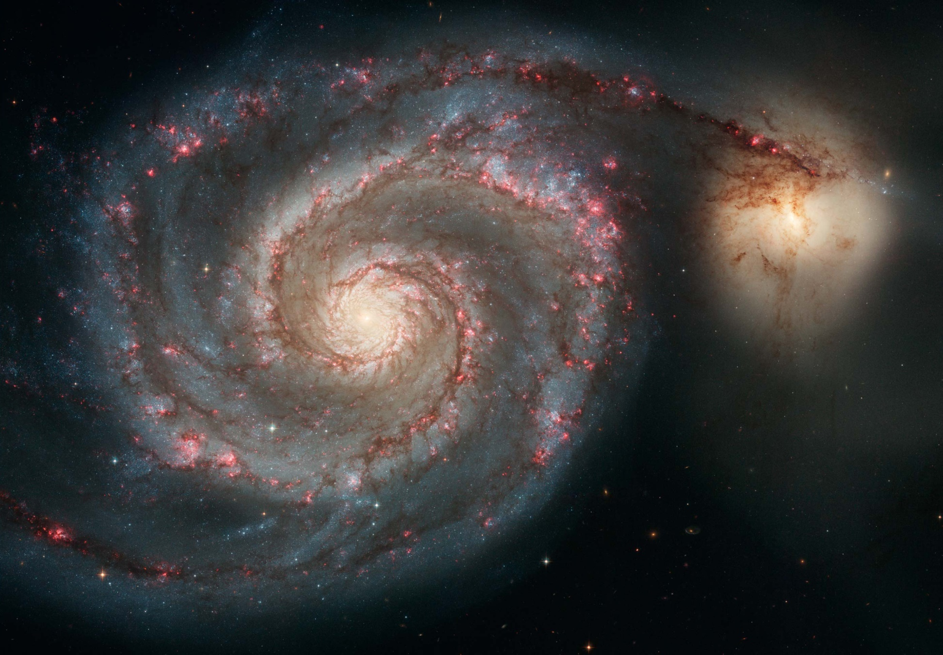
M51 (Whirlpool Galaxy) & NGC 5195
Notes:
M51 (the Whirlpool Galaxy/NGC 5194) and NGC 5195 are two interacting galaxies. The effect of the motions of these galaxies produced an accelerated spurt of star formation. The result of that is that M51 has produced 3 supernovas in the last 17 years!
https://apod.nasa.gov/apod/ap150502.html

Slide 31
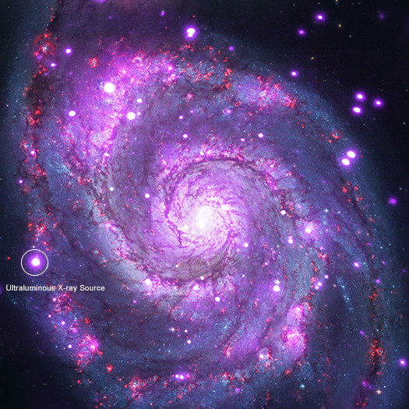
M51 (Whirlpool Galaxy) & ULX Source
Notes:
The M51 grand design spiral galaxy contains an ultra-luminous X-ray source (ULX) – a source that is less luminous than an active galactic nucleus (AGN) but consistently more luminous than known X-ray sources. These objects are interesting because they violate the Eddington Limit (AKA Eddington Luminosity) – the maximum luminosity an object can produce when there is a balance between the forces of radiation outwards and gravity inwards. This is called hydrostatic equilibrium. ULXs are less luminous than AGNs; however, they are more luminous than neutron stars and stellar mass black holes.
http://chandra.harvard.edu/photo/2018/m51/

Slide 32
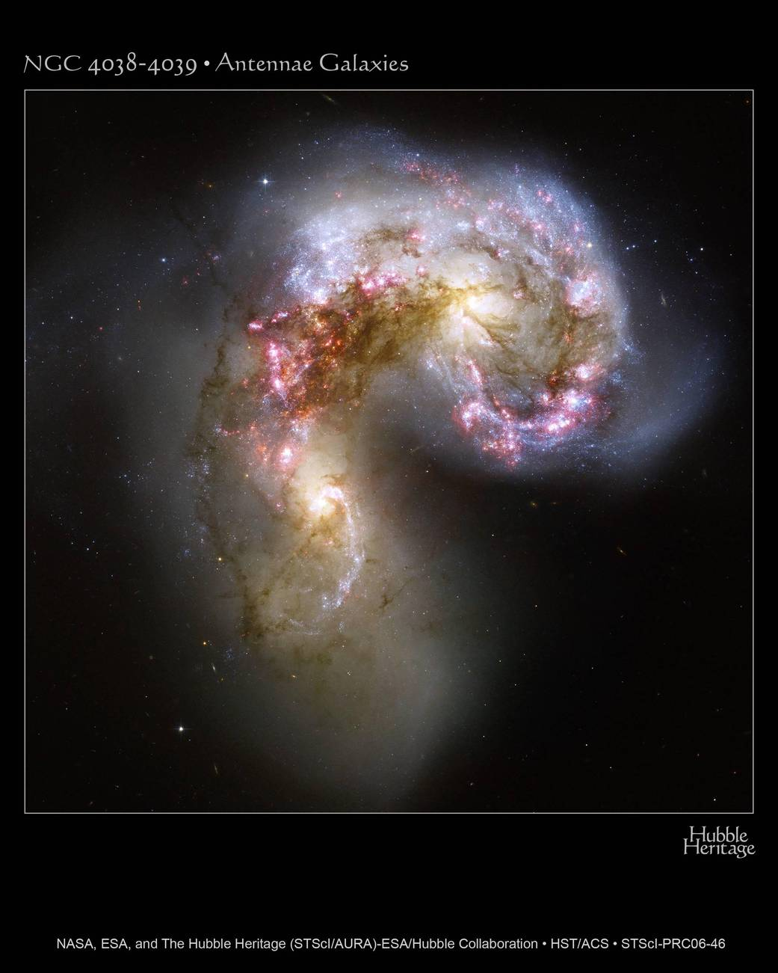
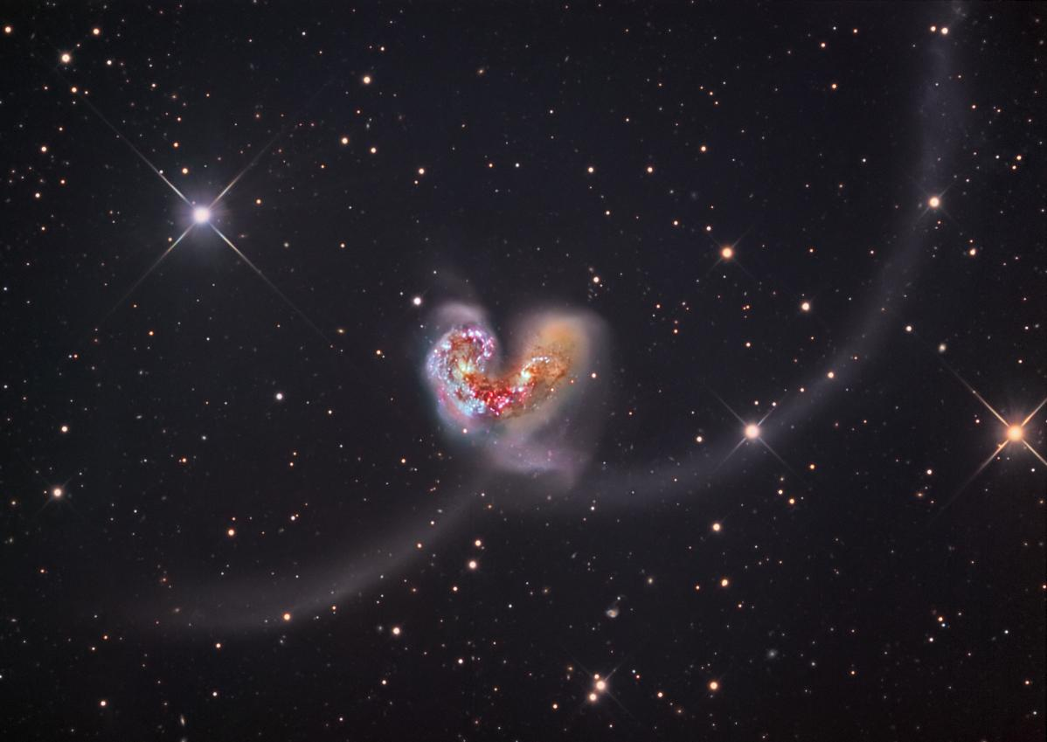
Antennae Galaxies – NGC 4038 & NGC 4039
Notes:
The Antennae are two interacting galaxies caught in the midst of a 100 million year collision which is ripping the smaller galaxy apart and the compression of the gas and dust has initiated massive star formation.
https://www.nasa.gov/multimedia/imagegallery/image_feature_1086.html
https://hubble25th.org/images/20

Slide 33

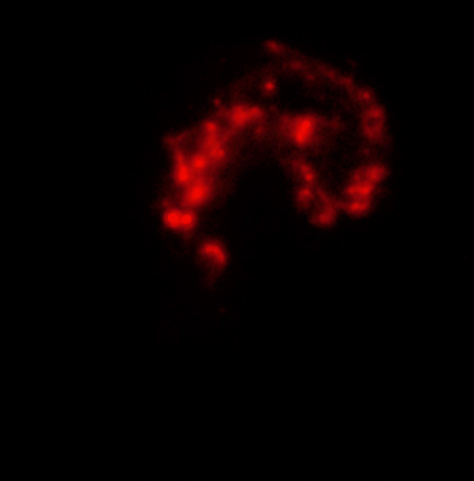


Antennae Galaxies – Hubble, Spitzer, Chandra
Notes:
This slide shows the Antennae galaxies in optical (Hubble, brown and gold), infrared (Spitzer, red) and X-ray (Chandra, blue) and a composite of all three wavelengths. The collision which initiated the formation of millions of stars has now resulted in several supernovas which enrich the interstellar medium with metals that will be incorporated into the next generation of star formation. The bright sources are produced by material falling onto black holes and neutron stars, the Spitzer IR data shows where dust clouds are being heated by newly forming stars, the Hubble data shows the older stars and star formation regions, and the Chandra observations show the hot clouds which have been formed.
https://apod.nasa.gov/apod/ap061024.html
http://chandra.harvard.edu/photo/2010/antennae/

Slide 34
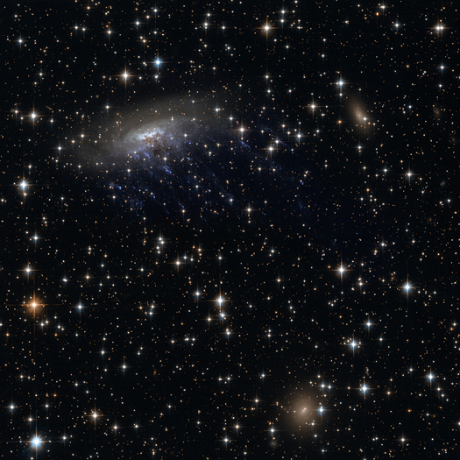

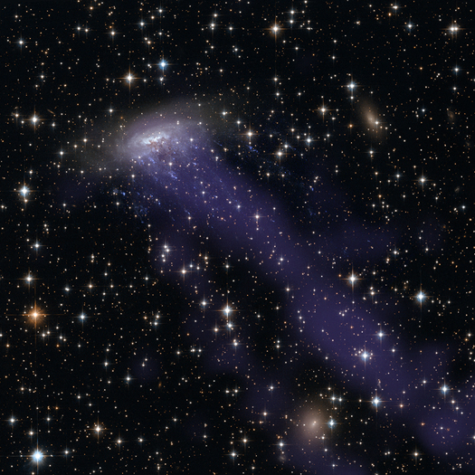
ESO 137-001
Notes:
ESO 137-001is a spiral galaxy in the Norma cluster, 200 million LY away. The first image is Hubble optical observations, followed by a Chandra X-ray image and a composite of Hubble and Chandra. This galaxy is subject to ram pressure stripping as it ploughs through the inter-cluster gas at 4.5 million MPH. This causes the galaxy to lose its gas and dust which means that there will be little material left for future star formation. The stripped gas is being left behind strung through the inter-cluster space creating a string of star formation in its wake – like dandelion seeds floating in the wind.
http://chandra.harvard.edu/photo/2014/eso137/

Slide 35
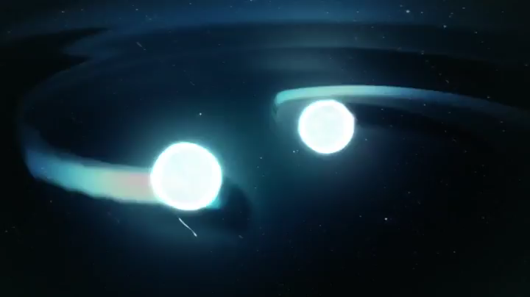
NGC 4993 & GW 170817
Notes:
An animation of the neutron star merger event.
Credit: NASA's Goddard Space Flight Center/CI Lab
https://www.youtube.com/watch?v=x_Akn8fUBeQ&feature=youtu.be

Slide 36
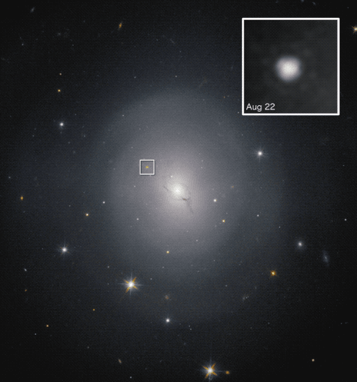
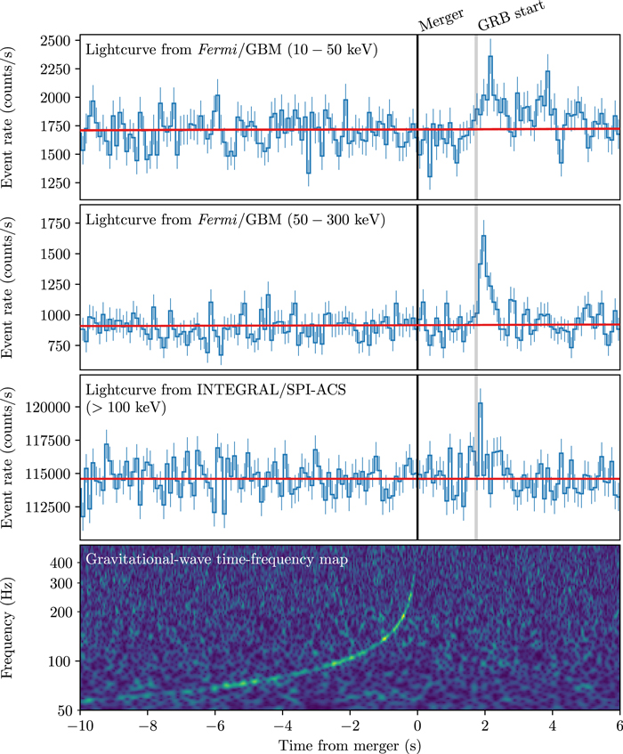
NGC 4993 & GW 170817
Notes:
NGC 4993 produced a gravitational wave named GW 170817. Unlike previously detected gravitational waves, this event included a gamma-ray burst and a kilonova which produced the light necessary to track down the source that produced the gravitational waves. The source was a collision of two neutron stars that merged, with tidal forces ripping off huge chunks while the remainder became a larger neutron star or a black hole. The freed neutrons turned back into protons and electrons and created elements heavier than iron. The light curve is from an animation of a 12-day sequence of the changing brightness of different wavelengths. There is a link in the notes section to the ESO website that hosts the animation.
https://www.nasa.gov/press-release/nasa-missions-catch-first-light-from-a-gravitational-wave-event
http://iopscience.iop.org/article/10.3847/2041-8213/aa920c/meta

Slide 37
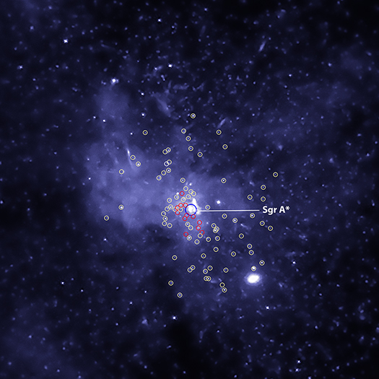
Sagittarius A*
Notes:
Sagittarius A* is the 4-million mass black hole at the center of the Milky Way Galaxy (MWG). Chandra’s legacy work will most probably be its contributions to our understanding of Sag A* through a multiplicity of observation over the past 19 and a half years. Chandra previously discovered a swarm of black holes in the disk surrounding Sag A*. This slide shows the evidence for thousands of stellar mass black holes between 5 and 30 solar masses in X-ray binary systems within 3 LY of Sag A*.
http://chandra.harvard.edu/photo/2018/sgra_swarm/
http://chandra.harvard.edu/photo/category/milkyway.html

Slide 38
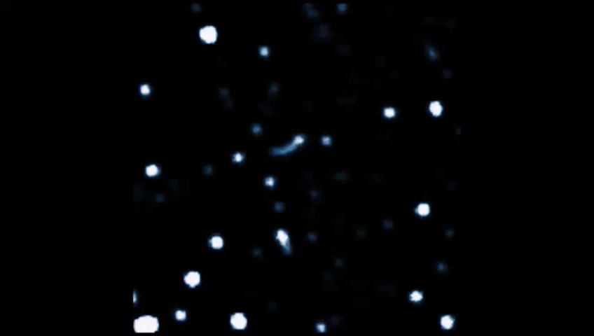
Sagittarius A*
Notes:
Footage of the galactic center taken over the span of 20 years. You can see stars orbit (one of them whips around) an invisible mass – this is the black hole! Another cool detail is that you can see the instrumentation get an upgrade about halfway through, bringing the stars to focus.
https://www.eso.org/public/news/eso1825/
https://www.eso.org/public/videos/eso1825e/

Slide 39
Outline
Event Description, 2019
Where to start?
Distance calculations
Deep Sky Objects (DSOs)
Resources

Slide 40

How to learn
Two aspects: studying and practicing
Not separate… it’s a feedback loop
Also: studying can be done solo, but practicing with partner helps build synergy (very important!)
Recommend a strategy that emphasizes both!

Slide 41
Studying
www.soinc.org/astronomy-c
Webinars, Rules clarifications, Coaches manual
www.scioly.org/wiki/index.php/Astronomy
Wiki, student notes, competition strategies
https://scioly.org/forums/viewtopic.php?f=285&t=12226
Astronomy forum: Ask other students questions
www.Wikipedia.org
Introduction to Modern Astrophysics, Carroll & Ostlie, 2nd edition
Not for the faint of heart

Slide 42
More resources
www.chandra.harvard.edu
www.stsci.edu/hst/
apod.nasa.gov
www.spitzer.caltech.edu/
www.public.nrao.edu/
Notes:
The resources listed with the event description are sufficient to prepare for competition. Always check out the resources on the NSO website. The Astronomy Picture of the Day (APOD) website is a good place to search and collect images. Search the APOD archive for the DSO’s, and the first page of images will show images in all wavelengths. The Chandra website has a variety of excellent stellar evolution materials and resources to help learn about stellar evolution, and the webinars are posted under the Education Menu. The Chandra, Hubble, NRAO, Spitzer and js9 websites are also valuable resources. The PowerPoint presentations for the webinars are posted on the NSO website with links to the webinars (Astronomy and Reach for the Stars) on the Chandra website along with transcripts for the webinars.

Slide 43
practicing
www.soinc.org/astronomy-c
Practice exams
www.scioly.org/wiki/index.php/Astronomy
More practice exams
Invitationals
Test exchanges

